Slide 1
CSE357:
COMBINATORIAL STUDIES

Slide 2


Slide 3
Unit III: Computer Networking Basics
Foundations of Computer Networks
Elements and Types of Networks
Data and Signals
Network Topologies and Transmission Medium
Network Models and Protocols
Understanding OSI and TCP/IP Models
Working of TCP/IP Model (Internet)
Subnetting and Routing
Key Protocols: HTTP, SMTP, POP/IMAP, FTP, DNS, DHCP
Overview of Traceroute and Ping

Slide 4
Networking Basics 1
Network
Protocol
IP Address
Router
Switch
Firewall
Gateway
Subnet
LAN (Local Area Network)
WAN (Wide Area Network)
DNS (Domain Name System)
DHCP (Dynamic Host Configuration Protocol)
Packet
Bandwidth
Latency
OSI Model
TCP (Transmission Control Protocol)

Slide 5
Networking Basics 2
UDP (User Datagram Protocol)
MAC Address
HTTPS (Hypertext Transfer Protocol Secure)
FTP (File Transfer Protocol)
SSL/TLS (Secure Sockets Layer/Transport Layer Security)
ARP (Address Resolution Protocol)
NAT (Network Address Translation)
QoS (Quality of Service)
DNS (Domain Name System)
VoIP (Voice over Internet Protocol)
DNS Spoofing
Ping
Traceroute
RIP (Routing Information Protocol)
OSPF (Open Shortest Path First)
LAN Party

Slide 6
Networking Basics 3
VPN (Virtual Private Network)
802.11 (Wi-Fi)
SNMP (Simple Network Management Protocol)
FTP (File Transfer Protocol)
PoE (Power over Ethernet)
IPsec (Internet Protocol Security)
SMTP (Simple Mail Transfer Protocol)
IMAP (Internet Message Access Protocol)
DDoS (Distributed Denial of Service)
Proxy Server
SMTP (Simple Mail Transfer Protocol)
IMAP (Internet Message Access Protocol)
POP3 (Post Office Protocol version 3)
IPsec (Internet Protocol Security)
Wireshark

Slide 7
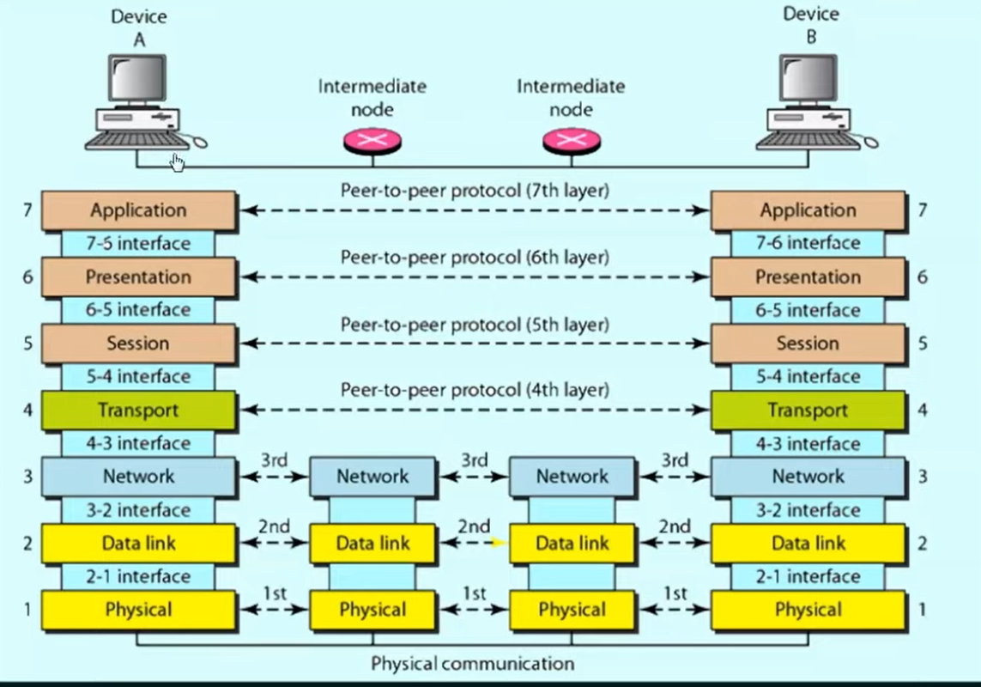
OSI Reference Model Layers
Application Layer
Presentation Layer
Session Layer
Transport Layer
Network Layer
Data Link Layer
Physical Layer

Slide 8
TCP/IP Model
Application Layer
Transport Layer
Internet Layer
Link Layer

Slide 9
Network Topologies
Bus Topology
Star Topology
Ring Topology
Mesh Topology
Tree Topology
Point-to-Point Topology
Wireless Mesh Topology

Slide 10
Network Devices
Router
Switch
Hub
Firewall
Gateway
Access Points
Modem
Bridge
Repeater
Proxy Server
Load Balancer
Network Attached Storage
VPN Concentrator

Slide 11
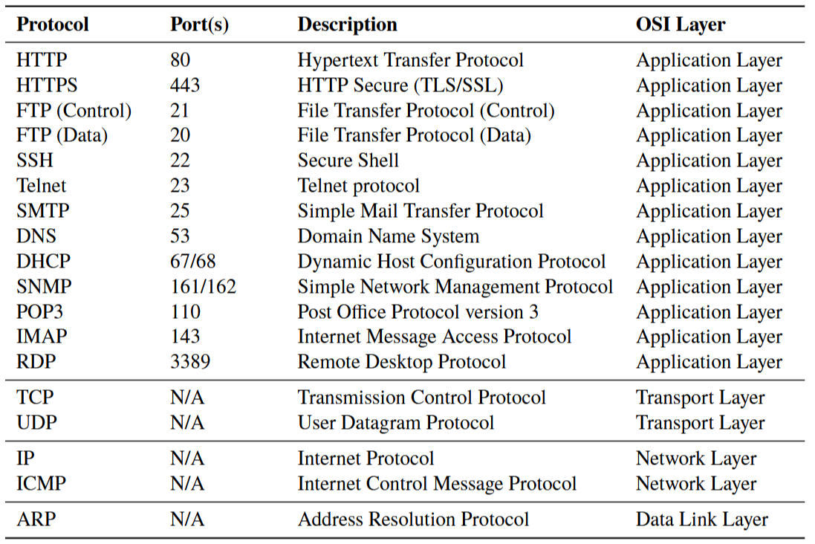
Network Protocols

Slide 12
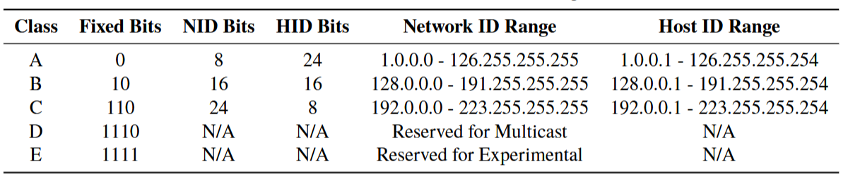
TCP/IP Protocol Suite
IP Addressing (IPv4 and IPv6)
IPv4 Addressing
IPv4 Components
Network Portion
Host Portion
IPv4 Classes

Slide 13
TCP/IP Protocol Suite
IP Addressing (IPv4 and IPv6)
IPv6 Addressing
IPv6 Components
Global Routing Prefix
Subnet ID
Interface ID
IPv6 Advantages
Address Space
Simplified Header
Autoconfiguration
IPv6 Address Types
Unicast Address
Multicast Address
Anycast Address

Slide 14
Subnetting
Subnetting divides a large IP network into smaller, more manageable sub-networks, or subnets.
Why Subnetting?
Efficient IP Address Utilization
Reduced Broadcast Domain
Improved Network Security
Simplified Network Management

Slide 15
Supernetting(Route Aggregation)
is a method used in computer networking to combine multiple smaller subnets into a single larger network.
Why Supernetting?
Reduced Routing Table Size
Simplified Network Configuration
Address Space Conservation

Slide 16
Ethernet
is a widely used networking technology that defines the rules for constructing and operating a local area network (LAN).
Key Points about Ethernet
Topology
Data Link Layer
Frame Format
CSMA/CD

Slide 17
IEEE 802.3
is a set of standards that govern the physical and data-link layers of wired Ethernet networks.
Key Features
Physical Layer Specifications
Data-Link Layer Specifications:
Speeds and Variants
Media Access Control (MAC)
Ethernet Frame Format
IEEE 802.3 Ethernet Standards

Slide 18
VLANs (Virtual LANs)
is a network segmentation and management technique that allows network administrators to logically divide a single physical local area network (LAN) into multiple isolated virtual LANs.
Purpose
Security
Flexibility
Broadcast Control

Slide 19
Routing
is the process of selecting the best path for network traffic to travel from the source to the destination in a computer network.
Key Aspects of Routing
Routing Process
Source and Destination
Packet Forwarding
Routing Tables
Information Repository
Decision Making
Routing Algorithms
Dynamic Routing
Static Routing

Slide 20
Routing Algorithms
Distance Vector Routing
Bellman-Ford Algorithm
RIP (Routing Information Protocol)
OSPF (Open Shortest Path First)
Link-State Routing Algorithm
Distance-Vector Routing Algorithm
Path Vector Routing Algorithm
BGP (Border Gateway Protocol)

Slide 21
IP Routing
is the process of forwarding packets from one network to another based on their destination IP addresses.
Key Components of IP Routing
Routing Table
Routing Protocols:
Routing Metrics
Static Routing

Slide 22
Supernetting(Route Aggregation)
is a method used in computer networking to combine multiple smaller subnets into a single larger network.
Why Supernetting?
Reduced Routing Table Size
Simplified Network Configuration
Address Space Conservation

Slide 23
Cryptography.
Sender
Receiver
Plain Text---→ Encryption----→Cipher Text-----→Decryption----→Plain Text
Symmetric Key Cryptography
Asymmetric Key Cryptography

Slide 24
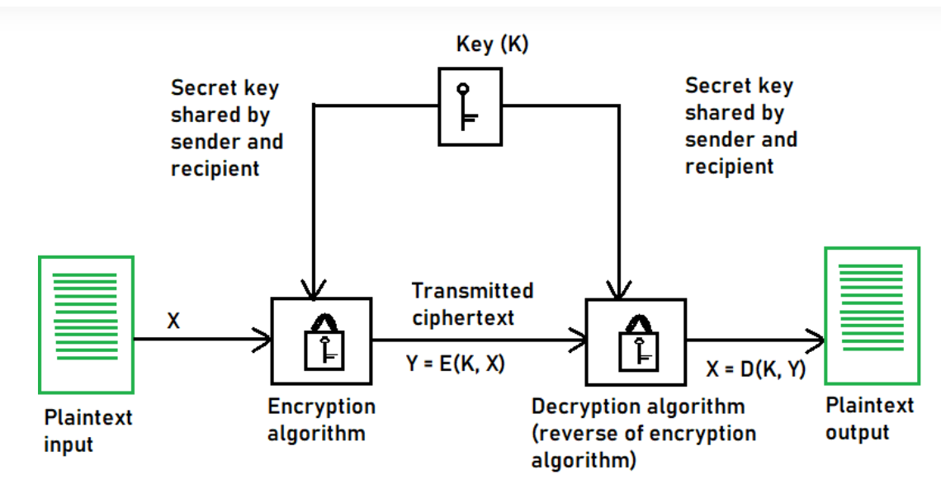
Cryptography..
Symmetric Key Cryptography
C=[K1[M]]--------------------------→M=[K1[C]]

Slide 25
Cryptography…
Symmetric Key Cryptography
DES(Data Encryption Standard) 56 bit
3DES(Triple Data Encryption Standard) 192 bit
AES (Advanced Encryption Standard) 128 bits, 192 bits, 256 bits
C=[K1[M]]--------------------------→M=[K1[C]]

Slide 26
Cryptography.…
Symmetric Key Cryptography (Questions)
Question 1: How many keys are required if we have four nodes?
Question 2: Suppose in a group of N people, everyone wants to communicate secretly with N-1 others using Symmetric Key and Asymmetric Key cryptography. Communication between any two people should not be decodable by others in group. The number of keys required in both cases are?

Slide 27
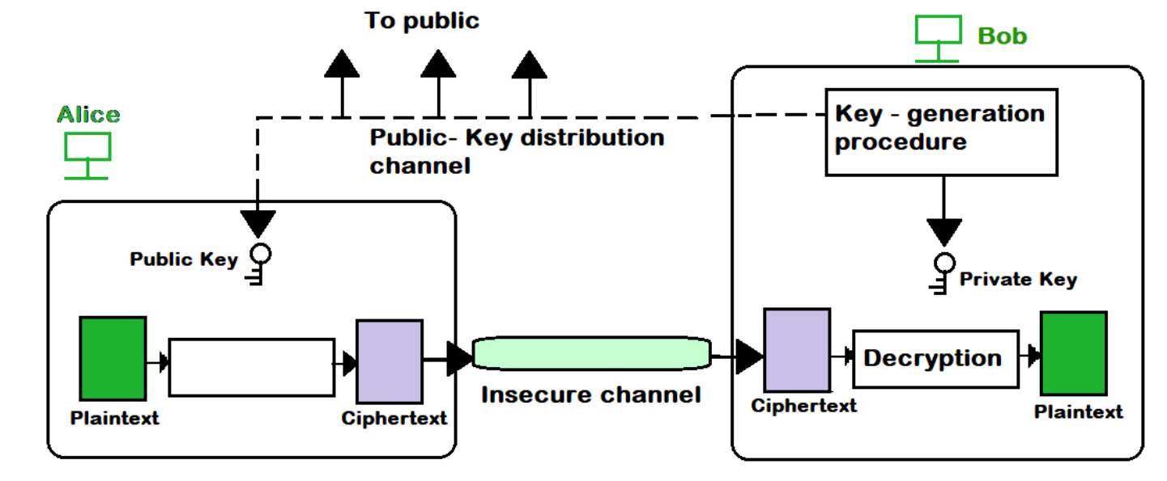
Cryptography…..
Asymmetric Key Cryptography or Public Key” RSA”
Two Keys (Public key and Private key)

Slide 28
Cryptography……
Asymmetric Key Cryptography or Public Key” RSA(Rivest-Shamir-Adleman)”
Step 1: Choose two different large random prime numbers
Step 2: Calculate n=p*q
Step 3: Calculate ф(n)=(p-1)*(q-1)
Step 4: Choose ‘e’ such that 1<e< ф(n) [e is co prime to ф(n), gcd(e, ф(n))=1
Step 5:Calculate d, such that de mod ф(n)=1 [de=1+K ф(n)/e k=0,1,2,3…]
Step 6:Public key ‘e’ Private Key ‘d’

Slide 29
Cryptography……
Asymmetric Key Cryptography or Public Key” RSA(Rivest-Shamir-Adleman)”
Question: In an RSA cryptosystem, a particular A uses two prime numbers, p=13 and q=17, to generate his public and private keys. If the Public Key of A is 35, then the Private Key of A is ________

Slide 30
Supernetting(Route Aggregation)
is a method used in computer networking to combine multiple smaller subnets into a single larger network.
Why Supernetting?
Reduced Routing Table Size
Simplified Network Configuration
Address Space Conservation

Slide 31
Supernetting(Route Aggregation)
is a method used in computer networking to combine multiple smaller subnets into a single larger network.
Why Supernetting?
Reduced Routing Table Size
Simplified Network Configuration
Address Space Conservation

Slide 32
Supernetting(Route Aggregation)
is a method used in computer networking to combine multiple smaller subnets into a single larger network.
Why Supernetting?
Reduced Routing Table Size
Simplified Network Configuration
Address Space Conservation

Slide 33
Supernetting(Route Aggregation)
is a method used in computer networking to combine multiple smaller subnets into a single larger network.
Why Supernetting?
Reduced Routing Table Size
Simplified Network Configuration
Address Space Conservation

Slide 34
Web Links For Reference (Complete Video Course)
https://youtube.com/playlist?list=PLZ2ps__7DhBYc4jkUk_yQAjYEVFzVzhdU&si=2cdYZiJa6NVwbJ6s
https://youtube.com/playlist?list=PLIwC9bZ0rmjSkm1VRJROX4vP2YMIf4Ebh&si=kH6pymcwWOLcGtqP
https://youtube.com/playlist?list=PLBlnK6fEyqRi_CUQ-FXxgzKQ1dwr_ZJWZ&si=vRmw_BpdGuBIhDkb

Slide 35
Web Links For Reference (Study Material)
https://www.appsierra.com/blog/database-normalization-tutorial
https://www.exasol.com/blog/what-is-a-relational-database/
https://www.geeksforgeeks.org/dbms/
https://db-book.com/slides-dir/
https://www.w3schools.com/sql/
https://www.javatpoint.com/dbms-tutorial
https://byjus.com/govt-exams/database-management-system-dbms/

Slide 36
NEXT----> Fundamentals of Programming Languages
C/C++/Java Interview Questions Overview,,
Variables, Data Types, and Memory,, Pointers and Storage, Classes,, Introduction to Object-Oriented
Programming (OOP),, Compiler and Interpreter Basics,, Understanding Process Loading and Linking,,
Techniques of Parameter Passing and Binding,, Storage Organization and Storage Classes,, Advanced
OOP Concepts and Data Structures, Abstract Data Types (ADTs),, Data Structure Principles,,
Advanced Programming Techniques,, Memory Handling in OOP Languages

